Slide 1
Formal verification of P Systems Using NuSMV
Luculescu Teodor - 351
Mihalache Sebastian-Ștefan - 352
Neculae Andrei-Fabian - 352

Slide 2
Cuprins
P System
NuSMV
Operația de împărțire
Numerele Fibonacci
Bibliografie
Link Github - https://github.com/Andrei137/Proiect-MFIS

Slide 3
P System
Un model computațional inspirat de structura și funcționarea celulei vii
Oferă un cadru puternic și flexibil pentru modelarea și analiza sistemelor bio-inspirate
Organizare ierarhică de compartimente separate prin membrane Fiecare compartiment conține:
Un multiset finit de obiecte
Un set finit de reguli
Alte compartimente (opțional)

Slide 4
NuSMV
= New Symbolic Model Verifier
Este un verificator de modele bazat pe logică temporală, care permite verificarea automată a proprietăților specificate asupra unui model formalizat al unui sistem
P Systems pot fi modelate ca structuri de tranziție finite (Kripke structures)
Verificarea formală oferă garanții riguroase privind corectitudinea sistemului și consolidează rezultatele obținute printr-o analiză exhaustivă
Putem verifica:
Invarianți (proprietăți care trebuie să fie mereu adevărate).
Proprietăți temporale (ce se întâmplă în timp)

Slide 5
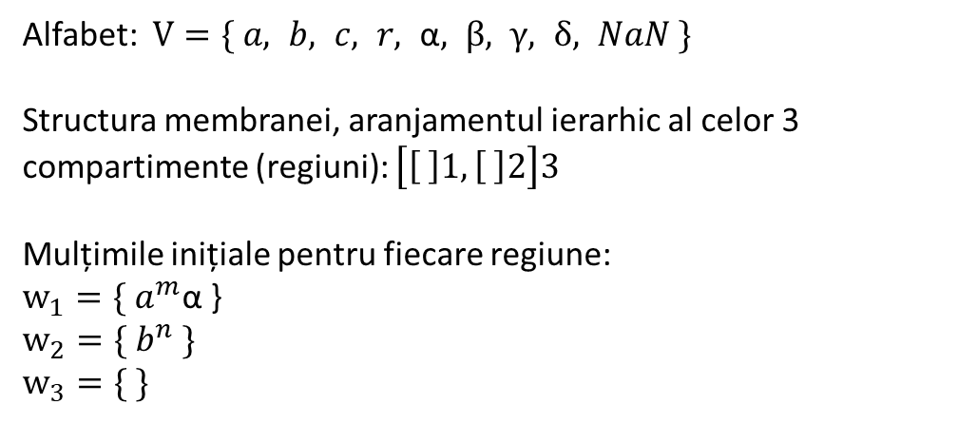
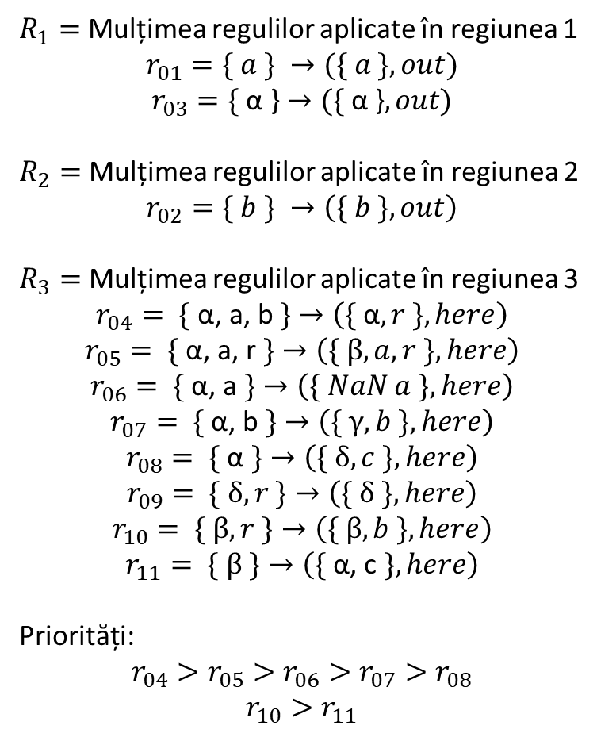


Reprezentarea operații de împărțire
Alfabet: $V=\{ a, b, c, r, \text{α}, β, γ, δ, NaN \}$
Structura membranei, aranjamentul ierarhic al celor 3 compartimente (regiuni): $\left[\left[ \right]1, \left[ \right]2\right]3$
Mulțimile inițiale pentru fiecare regiune:
$$w_{1}={\{ a}^{m}\text{α}\text{ \}}$$
$$w_{2}={\{ b}^{n} \}$$
$$w_{3}=\{ \}$$
$R_{1}=$ Mulțimea regulilor aplicate în regiunea 1
$$r_{01}=\{ a \} →(\{ a \}, out)$$
$$r_{03}=\text{\{ }\text{α}\text{ \}}→(\text{\{ }\text{α}\text{ \}}, out)$$
$R_{2}=$ Mulțimea regulilor aplicate în regiunea 2
$$r_{02}=\{ b \} →\left(\{ b \}, out\right)$$
$R_{3}=$ Mulțimea regulilor aplicate în regiunea 3
$$r_{04}=\text{ \{ }\text{α}\text{, }\text{a}\text{, }\text{b} \text{\}}→\left(\{ \text{α}, r \}, here\right)$$
$$r_{05}=\text{ \{ }\text{α}\text{, }\text{a}\text{, }\text{r} \text{\}}→\left(\{ β, a,r \}, here\right)$$
$$r_{06}=\text{ \{ }\text{α}\text{, }\text{a} \text{\}}→\left(\{ NaN a \}, here\right)$$
$$r_{07}=\text{ \{ }\text{α}\text{, }\text{b} \text{\}}→\left(\{ γ, b \}, here\right)$$
$$r_{08}=\text{ \{ }\text{α} \text{\}}→\left(\{ δ, c \}, here\right)$$
$$r_{09}=\text{ \{} δ, r \text{\}}→\left(\{ δ \}, here\right)$$
$$r_{10}=\text{ \{} β, r \text{\}}→\left(\{ β,b \}, here\right)$$
$$r_{11}=\text{ \{} β \text{\}}→\left(\{ \text{α}\text{, }\text{c} \}, here\right)$$
Priorități:
$$r_{04}>r_{05}>r_{06}>r_{07}>r_{08}$$
$$r_{10}>r_{11}$$
{ }
$${\{ a}^{m}\text{, }\text{α}\text{ \}}$$
$${\{ b}^{n} \}$$

Slide 6





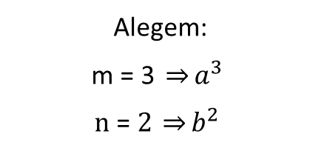

Exemplu pentru operația de împărțire
{ }
$$\{ \}$$
$${\{ a}^{m}\text{, }\text{α}\text{ \}}$$
$${\{ a}^{3}\text{α}\text{ \}}$$
$$Pasul 0$$
$${\{ b}^{n} \}$$
$${\{ b}^{2} \}$$
Alegem:
$$\text{m}\text{ = 3 }\underset{⇒}{}a^{3}$$
$$\text{n}\text{ = }2 \underset{⇒}{}b^{2}$$

Slide 7





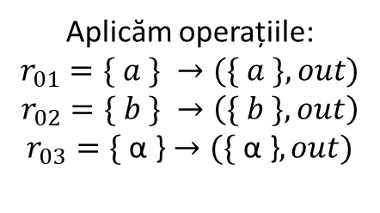



Exemplu pentru operația de împărțire
$$\{ \}$$
{ }
$${\{ a}^{3}\text{,} b^{2}\text{, }\text{α}\text{ \}}$$
$$\{ \}$$
$$\{ \}$$
$${\{ a}^{m}\text{α}\text{ \}}$$
$${\{ a}^{3}\text{α}\text{ \}}$$
$${\{ a}^{3}\text{α}\text{ \}}$$
$$Pasul 1$$
$${\{ b}^{n} \}$$
$${\{ b}^{2} \}$$
$${\{ b}^{2} \}$$
$$\{ \}$$
Aplicăm operațiile:
$$r_{01}=\{ a \} →(\{ a \}, out)$$
$$r_{02}=\{ b \} →\left(\{ b \}, out\right)$$
$$r_{03}=\text{\{ }\text{α}\text{ \}}→(\text{\{ }\text{α}\text{ \}}, out)$$

Slide 8





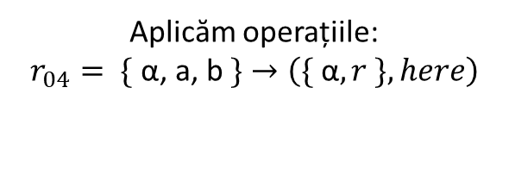


Exemplu pentru operația de împărțire
$$\{ \}$$
$${\{ a}^{2}\text{,}{ b}^{1}\text{,}{ r}^{1}\text{, }\text{α} \text{\}}$$
{ }
$${\{ a}^{3}\text{,} b^{2}\text{, }\text{α}\text{ \}}$$
$$\{ \}$$
$${\{ a}^{3}\text{,} b^{2}\text{, }\text{α}\text{ \}}$$
$$\{ \}$$
$$\{ \}$$
$$\{ \}$$
$${\{ a}^{3}\text{α}\text{ \}}$$
$${\{ a}^{m}\text{α}\text{ \}}$$
$${\{ a}^{3}\text{α}\text{ \}}$$
$$Pasul 2$$
$${\{ b}^{n} \}$$
$${\{ b}^{2} \}$$
$${\{ b}^{2} \}$$
$$\{ \}$$
$$\{ \}$$
$$\{ \}$$
Aplicăm operațiile:
$$r_{04}=\text{ \{ }\text{α}\text{, }\text{a}\text{, }\text{b} \text{\}}→\left(\{ \text{α}, r \}, here\right)$$

Slide 9




Exemplu pentru operația de împărțire
$$\{ \}$$
$${\{ a}^{2}\text{,}{ b}^{1}\text{,} \text{α}\text{,}{ r}^{1} \text{\}}$$
$${\{ a}^{1}\text{,}{ r}^{2}\text{, }\text{α}\text{\}}$$
{ }
$${\{ a}^{3}\text{,} b^{2}\text{, }\text{α}\text{ \}}$$
$$\{ \}$$
$${\{ a}^{3}\text{,} b^{2}\text{, }\text{α}\text{ \}}$$
$${\{ a}^{2}\text{,}{ b}^{1}\text{,}{ r}^{1}\text{, }\text{α} \text{\}}$$
$$\{ \}$$
$$\{ \}$$
$$\{ \}$$
$$\{ \}$$
$${\{ a}^{3}\text{α}\text{ \}}$$
$$\{ \}$$
$${\{ a}^{m}\text{α}\text{ \}}$$
$${\{ a}^{3}\text{α}\text{ \}}$$
$$Pasul \text{3}$$
$${\{ b}^{n} \}$$
$${\{ b}^{2} \}$$
$${\{ b}^{2} \}$$
$$\{ \}$$
$$\{ \}$$
$$\{ \}$$
$$\{ \}$$
$$\{ \}$$
Aplicăm operațiile:
$$r_{04}=\text{ \{ }\text{α}\text{, }\text{a}\text{, }\text{b} \text{\}}→\left(\{ \text{α}, r \}, here\right)$$

Slide 10








Exemplu pentru operația de împărțire
$${\{ a}^{1}\text{,}{ r}^{2}\text{,} β \text{\}}$$
$$\{ \}$$
$${\{ a}^{2}\text{,}{ b}^{1}\text{,} \text{α}\text{,}{ r}^{1} \text{\}}$$
$${\{ a}^{1}\text{, }\text{α}\text{,}{ r}^{2} \text{\}}$$
{ }
$${\{ a}^{3}\text{,} b^{2}\text{, }\text{α}\text{ \}}$$
$$\{ \}$$
$${\{ a}^{3}\text{,} b^{2}\text{, }\text{α}\text{ \}}$$
$${\{ a}^{2}\text{,}{ b}^{1}\text{,} \text{α}\text{,}{ r}^{1} \text{\}}$$
$${\{ a}^{1}\text{,}{ r}^{2}\text{, }\text{α}\text{\}}$$
$$\{ \}$$
$$\{ \}$$
$$\{ \}$$
$$\{ \}$$
$$\{ \}$$
$${\{ a}^{3}\text{α}\text{ \}}$$
$$\{ \}$$
$$\{ \}$$
$${\{ a}^{m}\text{α}\text{ \}}$$
$${\{ a}^{3}\text{α}\text{ \}}$$
$$Pasul \text{4}$$
$${\{ b}^{n} \}$$
$${\{ b}^{2} \}$$
$${\{ b}^{2} \}$$
$$\{ \}$$
$$\{ \}$$
$$\{ \}$$
$$\{ \}$$
$$\{ \}$$
$$\{ \}$$
$$\{ \}$$
Aplicăm operațiile:
$$r_{05}=\text{ \{ }\text{α}\text{, }\text{a}\text{, }\text{r} \text{\}}→\left(\{ β, a,r \}, here\right)$$

Slide 11






Exemplu pentru operația de împărțire
$${\{ a}^{1}\text{,} { b}^{1}\text{,}{ r}^{1}, β \text{\}}$$
$${\{ a}^{1}\text{,} β\text{,}{ r}^{1} \text{\}}$$
$$\{ \}$$
$${\{ a}^{2}\text{,}{ b}^{1}\text{,} \text{α}\text{,}{ r}^{1} \text{\}}$$
$${\{ a}^{1}\text{, }\text{α}\text{,}{ r}^{2} \text{\}}$$
{ }
$${\{ a}^{3}\text{,} b^{2}\text{, }\text{α}\text{ \}}$$
$$\{ \}$$
$${\{ a}^{3}\text{,} b^{2}\text{, }\text{α}\text{ \}}$$
$${\{ a}^{2}\text{,}{ b}^{1}\text{,} \text{α}\text{,}{ r}^{1} \text{\}}$$
$${\{ a}^{1}\text{, }\text{α}\text{,}{ r}^{2} \text{\}}$$
$${\{ a}^{1}\text{,} { r}^{2}, β \text{\}}$$
$$\{ \}$$
$$\{ \}$$
$$\{ \}$$
$$\{ \}$$
$$\{ \}$$
$$\{ \}$$
$${\{ a}^{3}\text{α}\text{ \}}$$
$$\{ \}$$
$$\{ \}$$
$$\{ \}$$
$${\{ a}^{m}\text{α}\text{ \}}$$
$${\{ a}^{3}\text{α}\text{ \}}$$
$$Pasul \text{5}$$
$${\{ b}^{n} \}$$
$${\{ b}^{2} \}$$
$${\{ b}^{2} \}$$
$$\{ \}$$
$$\{ \}$$
$$\{ \}$$
$$\{ \}$$
$$\{ \}$$
$$\{ \}$$
$$\{ \}$$
$$\{ \}$$
$$\{ \}$$
Aplicăm operațiile:
$$r_{10}=\text{ \{} β, r \text{\}}→\left(\{ β,b \}, here\right)$$

Slide 12






Exemplu pentru operația de împărțire
$${\{ a}^{1}\text{,} { b}^{2}, β \text{\}}$$
$${\{ a}^{1}\text{,} β\text{,}{ r}^{1} \text{\}}$$
$$\{ \}$$
$${\{ a}^{2}\text{,}{ b}^{1}\text{,} \text{α}\text{,}{ r}^{1} \text{\}}$$
$${\{ a}^{1}\text{, }\text{α}\text{,}{ r}^{2} \text{\}}$$
$${\{ a}^{1}\text{,} { b}^{1}\text{,}{ r}^{1}\text{,} β \text{\}}$$
$${\{ a}^{3}\text{,} b^{2}\text{, }\text{α}\text{ \}}$$
{ }
$$\{ \}$$
$${\{ a}^{3}\text{,} b^{2}\text{, }\text{α}\text{ \}}$$
$${\{ a}^{2}\text{,}{ b}^{1}\text{,} \text{α}\text{,}{ r}^{1} \text{\}}$$
$${\{ a}^{1}\text{, }\text{α}\text{,}{ r}^{2} \text{\}}$$
$${\{ a}^{1}\text{,} β\text{,}{ r}^{1} \text{\}}$$
$$\{ \}$$
$$\{ \}$$
$$\{ \}$$
$$\{ \}$$
$$\{ \}$$
$$\{ \}$$
$${\{ a}^{3}\text{α}\text{ \}}$$
$$\{ \}$$
$$\{ \}$$
$$\{ \}$$
$$\{ \}$$
$${\{ a}^{m}\text{α}\text{ \}}$$
$${\{ a}^{3}\text{α}\text{ \}}$$
$$Pasul \text{6}$$
$${\{ b}^{n} \}$$
$${\{ b}^{2} \}$$
$${\{ b}^{2} \}$$
$$\{ \}$$
$$\{ \}$$
$$\{ \}$$
$$\{ \}$$
$$\{ \}$$
$$\{ \}$$
$$\{ \}$$
$$\{ \}$$
$$\{ \}$$
$$\{ \}$$
Aplicăm operațiile:
$$r_{10}=\text{ \{} β, r \text{\}}→\left(\{ β,b \}, here\right)$$

Slide 13







Exemplu pentru operația de împărțire
$${\{ a}^{1}\text{,} { b}^{2},{ c}^{1},α \text{\}}$$
$${\{ a}^{1}\text{,} β\text{,}{ r}^{1} \text{\}}$$
$$\{ \}$$
$${\{ a}^{2}\text{,}{ b}^{1}\text{,} \text{α}\text{,}{ r}^{1} \text{\}}$$
$${\{ a}^{1}\text{, }\text{α}\text{,}{ r}^{2} \text{\}}$$
$${\{ a}^{1}\text{,} { b}^{1}, β\text{,}{ r}^{1} \text{\}}$$
$${\{ a}^{3}\text{,} b^{2}\text{, }\text{α}\text{ \}}$$
{ }
$$\{ \}$$
$${\{ a}^{3}\text{,} b^{2}\text{, }\text{α}\text{ \}}$$
$${\{ a}^{2}\text{,}{ b}^{1}\text{,} \text{α}\text{,}{ r}^{1} \text{\}}$$
$${\{ a}^{1}\text{, }\text{α}\text{,}{ r}^{2} \text{\}}$$
$${\{ a}^{1}\text{,} β\text{,}{ r}^{1} \text{\}}$$
$${\{ a}^{1}\text{,} { b}^{2}, β \text{\}}$$
$$\{ \}$$
$$\{ \}$$
$$\{ \}$$
$$\{ \}$$
$$\{ \}$$
$$\{ \}$$
$${\{ a}^{3}\text{α}\text{ \}}$$
$$\{ \}$$
$$\{ \}$$
$$\{ \}$$
$$\{ \}$$
$${\{ a}^{m}\text{α}\text{ \}}$$
$${\{ a}^{3}\text{α}\text{ \}}$$
$$\{ \}$$
$$Pasul 7$$
$${\{ b}^{n} \}$$
$${\{ b}^{2} \}$$
$${\{ b}^{2} \}$$
$$\{ \}$$
$$\{ \}$$
$$\{ \}$$
$$\{ \}$$
$$\{ \}$$
$$\{ \}$$
$$\{ \}$$
$$\{ \}$$
$$\{ \}$$
$$\{ \}$$
$$\{ \}$$
Aplicăm operațiile:
$$r_{11}=\text{ \{} β \text{\}}→\left(\{ \text{α}\text{, }\text{c} \}, here\right)$$

Slide 14






Exemplu pentru operația de împărțire
$$\{{ b}^{1},{ c}^{1},{ r}^{1}, α\text{\}}$$
$${\{ a}^{1}\text{,} β\text{,}{ r}^{1} \text{\}}$$
$$\{ \}$$
$${\{ a}^{2}\text{,}{ b}^{1}\text{,} \text{α}\text{,}{ r}^{1} \text{\}}$$
$${\{ a}^{1}\text{, }\text{α}\text{,}{ r}^{2} \text{\}}$$
$${\{ a}^{1}\text{,} { b}^{1}, β\text{,}{ r}^{1} \text{\}}$$
$${\{ a}^{3}\text{,} b^{2}\text{, }\text{α}\text{ \}}$$
{ }
$$\{ \}$$
$${\{ a}^{3}\text{,} b^{2}\text{, }\text{α}\text{ \}}$$
$${\{ a}^{2}\text{,}{ b}^{1}\text{,} \text{α}\text{,}{ r}^{1} \text{\}}$$
$${\{ a}^{1}\text{, }\text{α}\text{,}{ r}^{2} \text{\}}$$
$${\{ a}^{1}\text{,} β\text{,}{ r}^{1} \text{\}}$$
$${\{ a}^{1}\text{,} { b}^{2}, β \text{\}}$$
$${\{ a}^{1}\text{,} { b}^{2},{ c}^{1},α \text{\}}$$
$$\{ \}$$
$$\{ \}$$
$$\{ \}$$
$$\{ \}$$
$$\{ \}$$
$$\{ \}$$
$${\{ a}^{3}\text{α}\text{ \}}$$
$$\{ \}$$
$$\{ \}$$
$$\{ \}$$
$$\{ \}$$
$${\{ a}^{m}\text{α}\text{ \}}$$
$${\{ a}^{3}\text{α}\text{ \}}$$
$$\{ \}$$
$$\{ \}$$
$$Pasul 8$$
$${\{ b}^{n} \}$$
$${\{ b}^{2} \}$$
$${\{ b}^{2} \}$$
$$\{ \}$$
$$\{ \}$$
$$\{ \}$$
$$\{ \}$$
$$\{ \}$$
$$\{ \}$$
$$\{ \}$$
$$\{ \}$$
$$\{ \}$$
$$\{ \}$$
$$\{ \}$$
$$\{ \}$$
Aplicăm operațiile:
$$r_{04}=\text{ \{ }\text{α}\text{, }\text{a}\text{, }\text{b} \text{\}}→\left(\{ \text{α}, r \}, here\right)$$

Slide 15




Exemplu pentru operația de împărțire
$$\{{ b}^{1},{ c}^{1},{ r}^{1},γ\text{\}}$$
$${\{ a}^{1}\text{,} β\text{,}{ r}^{1} \text{\}}$$
$$\{ \}$$
$${\{ a}^{2}\text{,}{ b}^{1}\text{,} \text{α}\text{,}{ r}^{1} \text{\}}$$
$${\{ a}^{1}\text{, }\text{α}\text{,}{ r}^{2} \text{\}}$$
$${\{ a}^{1}\text{,} { b}^{1}, β\text{,}{ r}^{1} \text{\}}$$
$${\{ a}^{3}\text{,} b^{2}\text{, }\text{α}\text{ \}}$$
{ }
$$\{ \}$$
$${\{ a}^{3}\text{,} b^{2}\text{, }\text{α}\text{ \}}$$
$${\{ a}^{2}\text{,}{ b}^{1}\text{,} \text{α}\text{,}{ r}^{1} \text{\}}$$
$${\{ a}^{1}\text{, }\text{α}\text{,}{ r}^{2} \text{\}}$$
$${\{ a}^{1}\text{,} β\text{,}{ r}^{1} \text{\}}$$
$${\{ a}^{1}\text{,} { b}^{2}, β \text{\}}$$
$$\{{ b}^{1},{ c}^{1},{ r}^{1}, α \text{\}}$$
$${\{ a}^{1}\text{,} { b}^{2},{ c}^{1},α \text{\}}$$
$$\{ \}$$
$$\{ \}$$
$$\{ \}$$
$$\{ \}$$
$$\{ \}$$
$$\{ \}$$
$${\{ a}^{3}\text{α}\text{ \}}$$
$$\{ \}$$
$$\{ \}$$
$$\{ \}$$
$$\{ \}$$
$${\{ a}^{m}\text{α}\text{ \}}$$
$${\{ a}^{3}\text{α}\text{ \}}$$
$$\{ \}$$
$$\{ \}$$
$$\{ \}$$
$$Pasul 9$$
$${\{ b}^{n} \}$$
$${\{ b}^{2} \}$$
$${\{ b}^{2} \}$$
$$\{ \}$$
$$\{ \}$$
$$\{ \}$$
$$\{ \}$$
$$\{ \}$$
$$\{ \}$$
$$\{ \}$$
$$\{ \}$$
$$\{ \}$$
$$\{ \}$$
$$\{ \}$$
$$\{ \}$$
$$\{ \}$$
Aplicăm operațiile:
$$r_{07}=\text{ \{ }\text{α}\text{, }\text{b} \text{\}}→\left(\{ γ, b \}, here\right)$$

Slide 16




Exemplu pentru operația de împărțire
$$FINAL$$
$$\{{ b}^{1},{ c}^{1},{ r}^{1},γ\text{\}}$$
$${\{ a}^{1}\text{,} β\text{,}{ r}^{1} \text{\}}$$
$$\{ \}$$
$${\{ a}^{2}\text{,}{ b}^{1}\text{,} \text{α}\text{,}{ r}^{1} \text{\}}$$
$${\{ a}^{1}\text{, }\text{α}\text{,}{ r}^{2} \text{\}}$$
$$\{{ b}^{1},{ c}^{1},{ r}^{1},γ\text{\}}$$
$${\{ a}^{3}\text{,} b^{2}\text{, }\text{α}\text{ \}}$$
$${\{ a}^{1}\text{,} { b}^{1}, β\text{,}{ r}^{1} \text{\}}$$
{ }
$$\{ \}$$
$${\{ a}^{3}\text{,} b^{2}\text{, }\text{α}\text{ \}}$$
$${\{ a}^{2}\text{,}{ b}^{1}\text{,} \text{α}\text{,}{ r}^{1} \text{\}}$$
$${\{ a}^{1}\text{, }\text{α}\text{,}{ r}^{2} \text{\}}$$
$${\{ a}^{1}\text{,} β\text{,}{ r}^{1} \text{\}}$$
$${\{ a}^{1}\text{,} { b}^{2}, β \text{\}}$$
$$\{{ b}^{1},{ c}^{1},{ r}^{1}, α \text{\}}$$
$${\{ a}^{1}\text{,} { b}^{2},{ c}^{1},α \text{\}}$$
$$\{ \}$$
$$\{ \}$$
$$\{ \}$$
$$\{ \}$$
$$\{ \}$$
$$\{ \}$$
$${\{ a}^{3}\text{α}\text{ \}}$$
$$\{ \}$$
$$\{ \}$$
$$\{ \}$$
$$\{ \}$$
$$\{ \}$$
$${\{ a}^{m}\text{α}\text{ \}}$$
$${\{ a}^{3}\text{α}\text{ \}}$$
$$\{ \}$$
$$\{ \}$$
$$\{ \}$$
$$Pasul 10$$
$${\{ b}^{n} \}$$
$${\{ b}^{2} \}$$
$${\{ b}^{2} \}$$
$$\{ \}$$
$$\{ \}$$
$$\{ \}$$
$$\{ \}$$
$$\{ \}$$
$$\{ \}$$
$$\{ \}$$
$$\{ \}$$
$$\{ \}$$
$$\{ \}$$
$$\{ \}$$
$$\{ \}$$
$$\{ \}$$
$$\{ \}$$
Aplicăm operațiile:
$$r_{07}=\text{ \{ }\text{α}\text{, }\text{b} \text{\}}→\left(\{ γ, b \}, here\right)$$

Slide 17
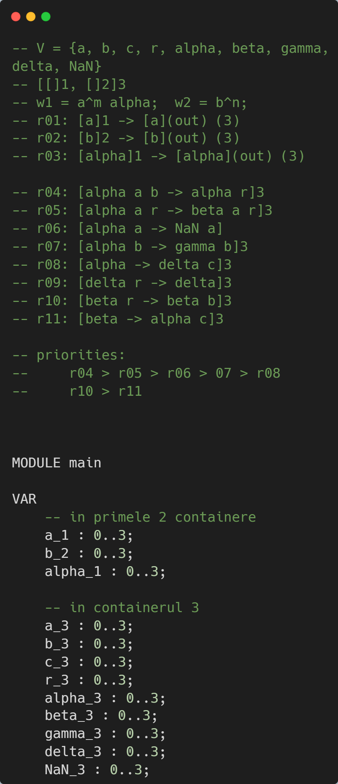
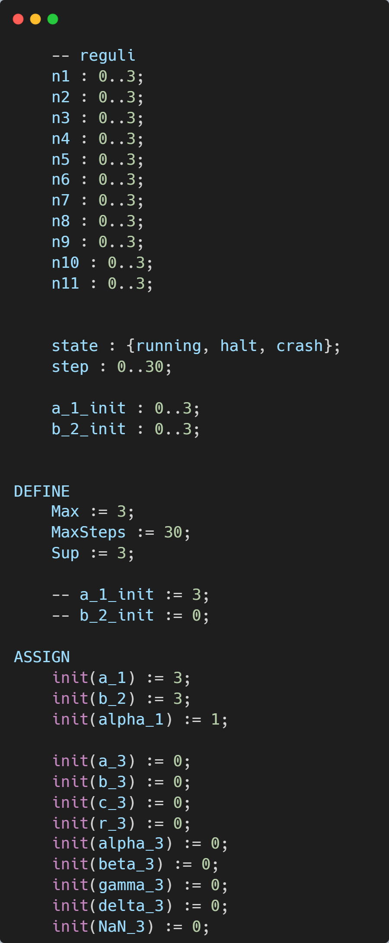
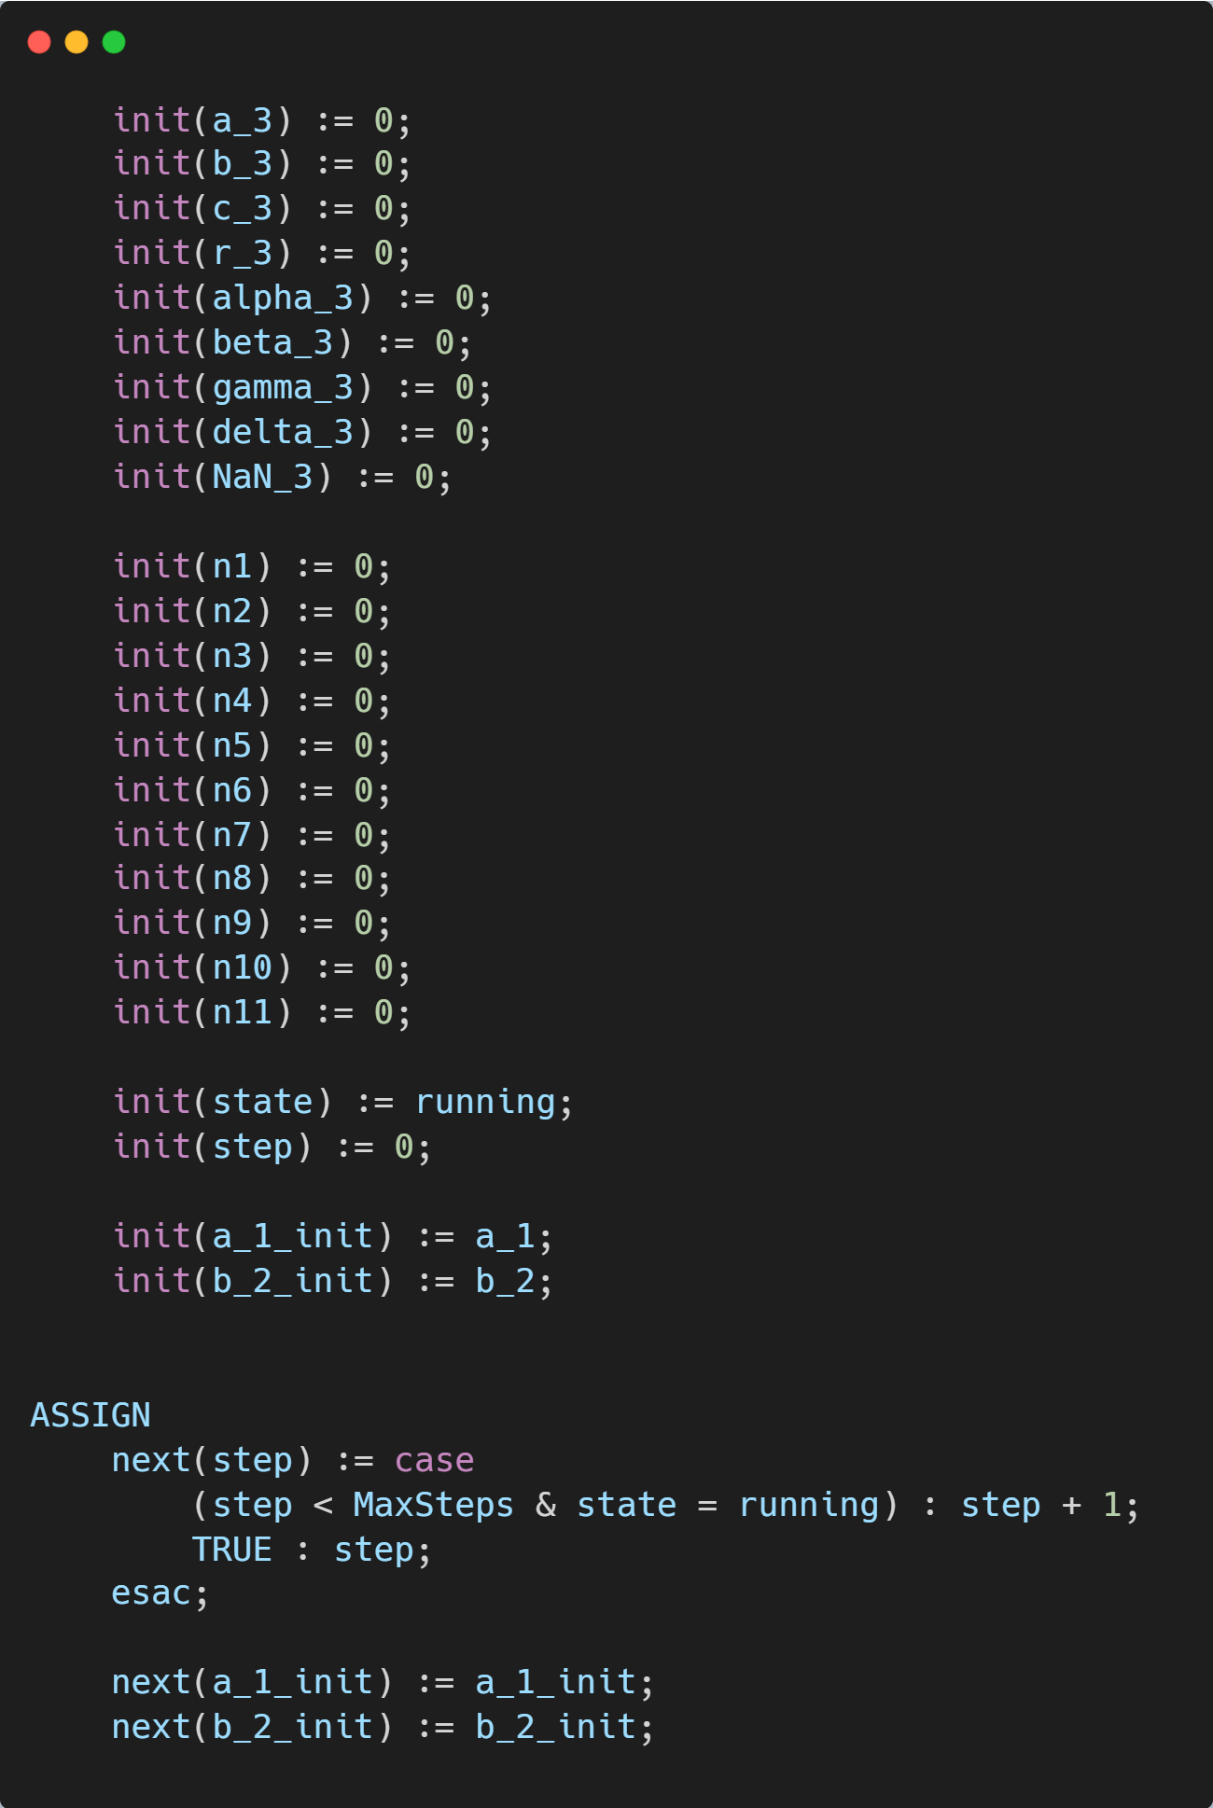
Codul NuSMV pentru operația de împărțire

Slide 18
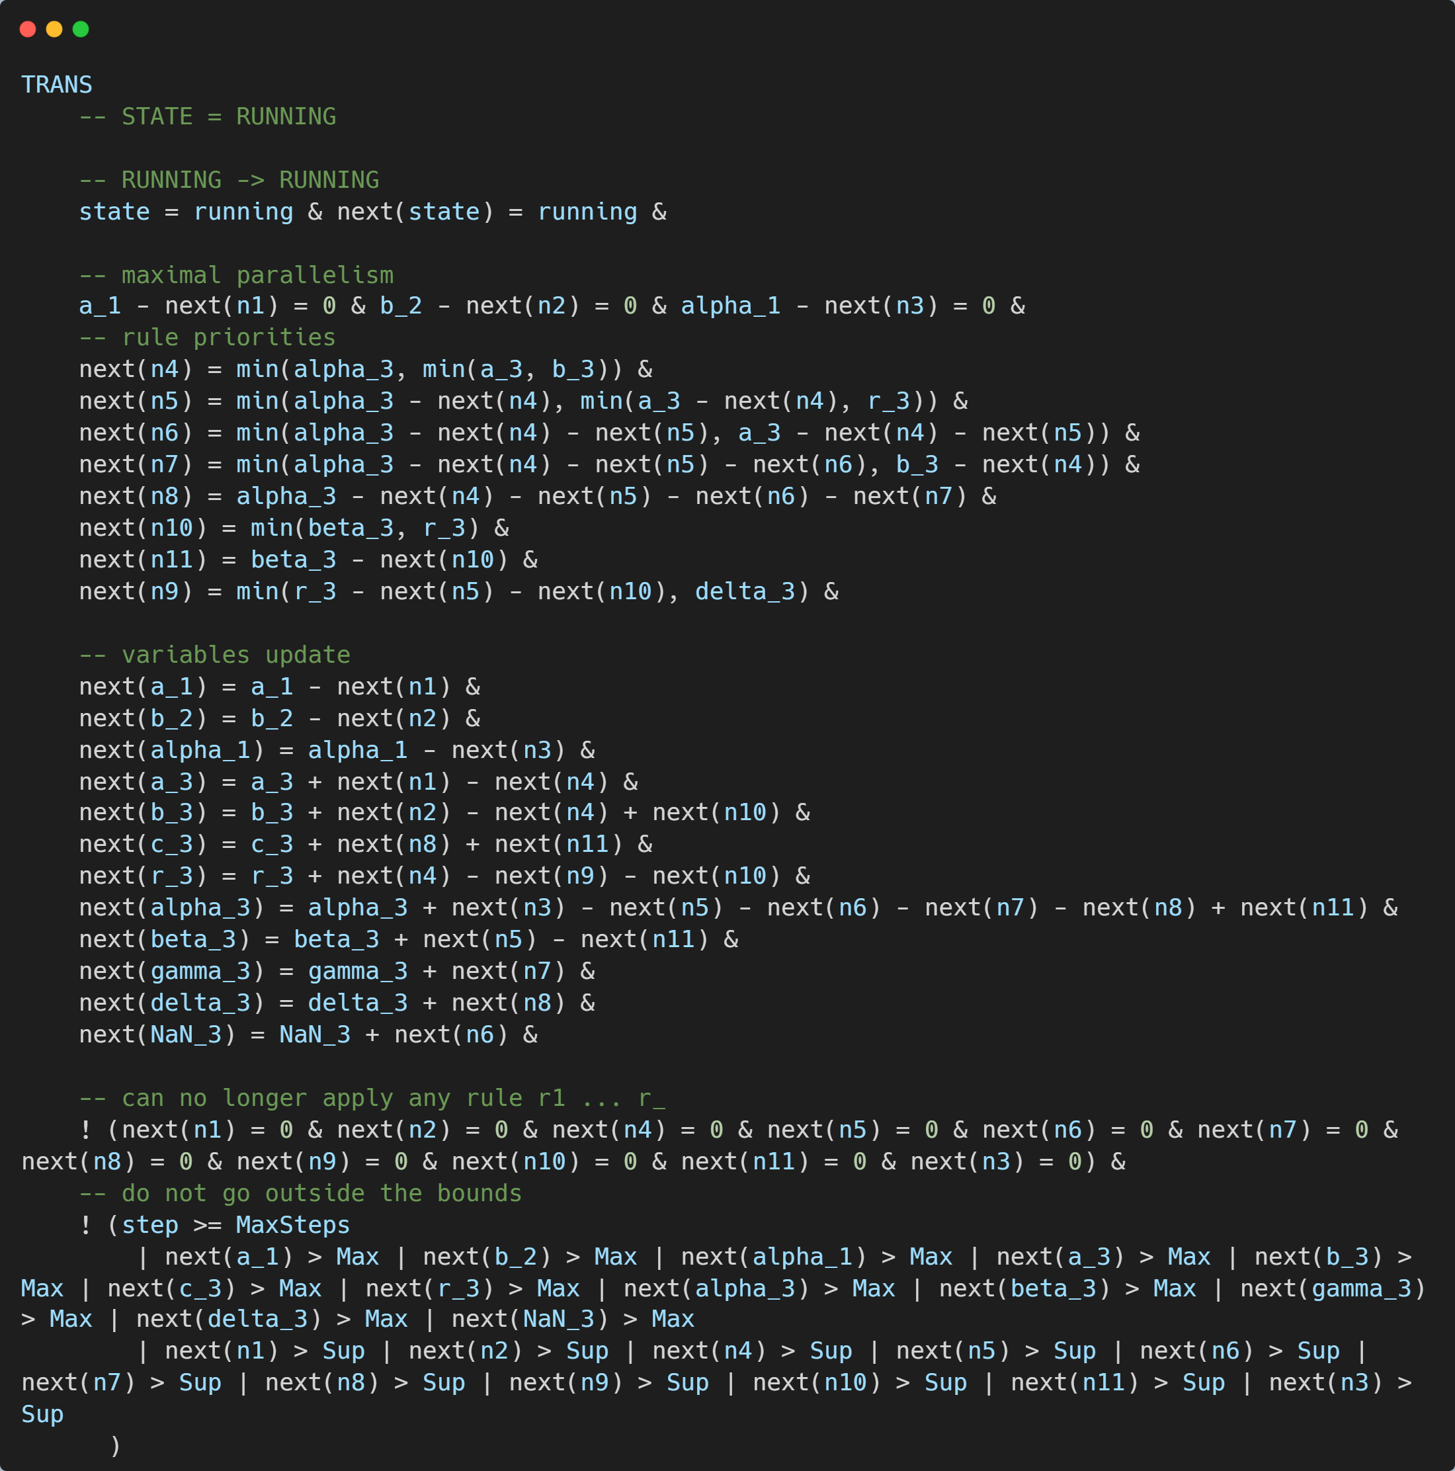
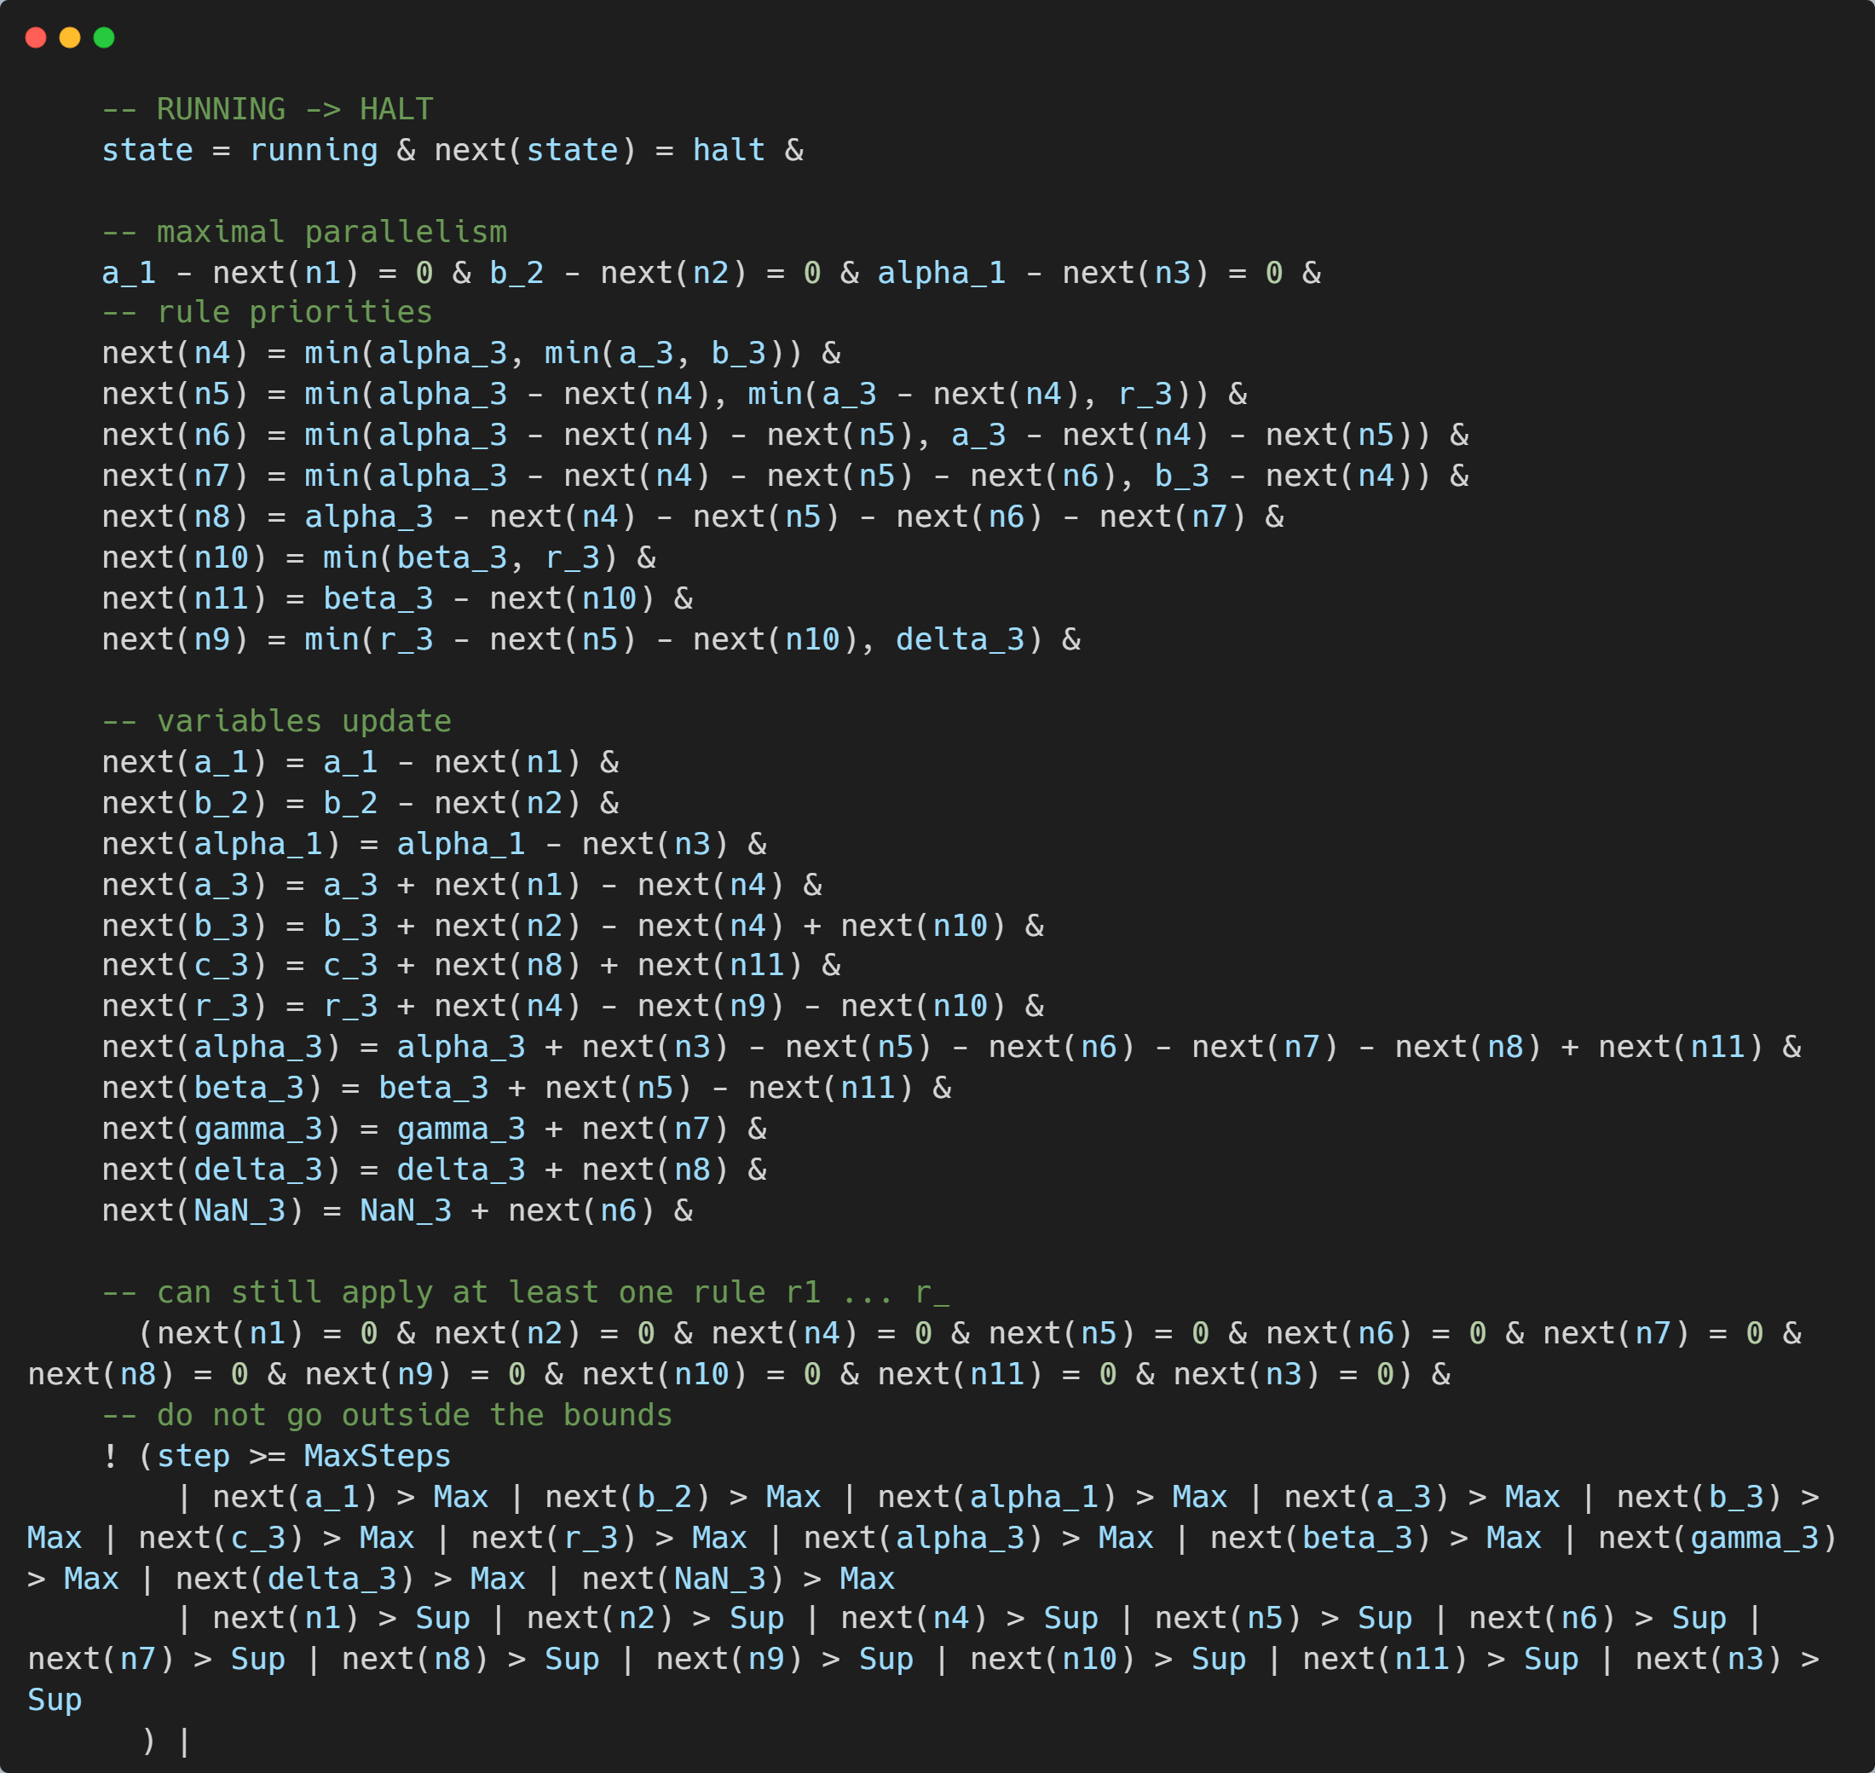

Slide 19
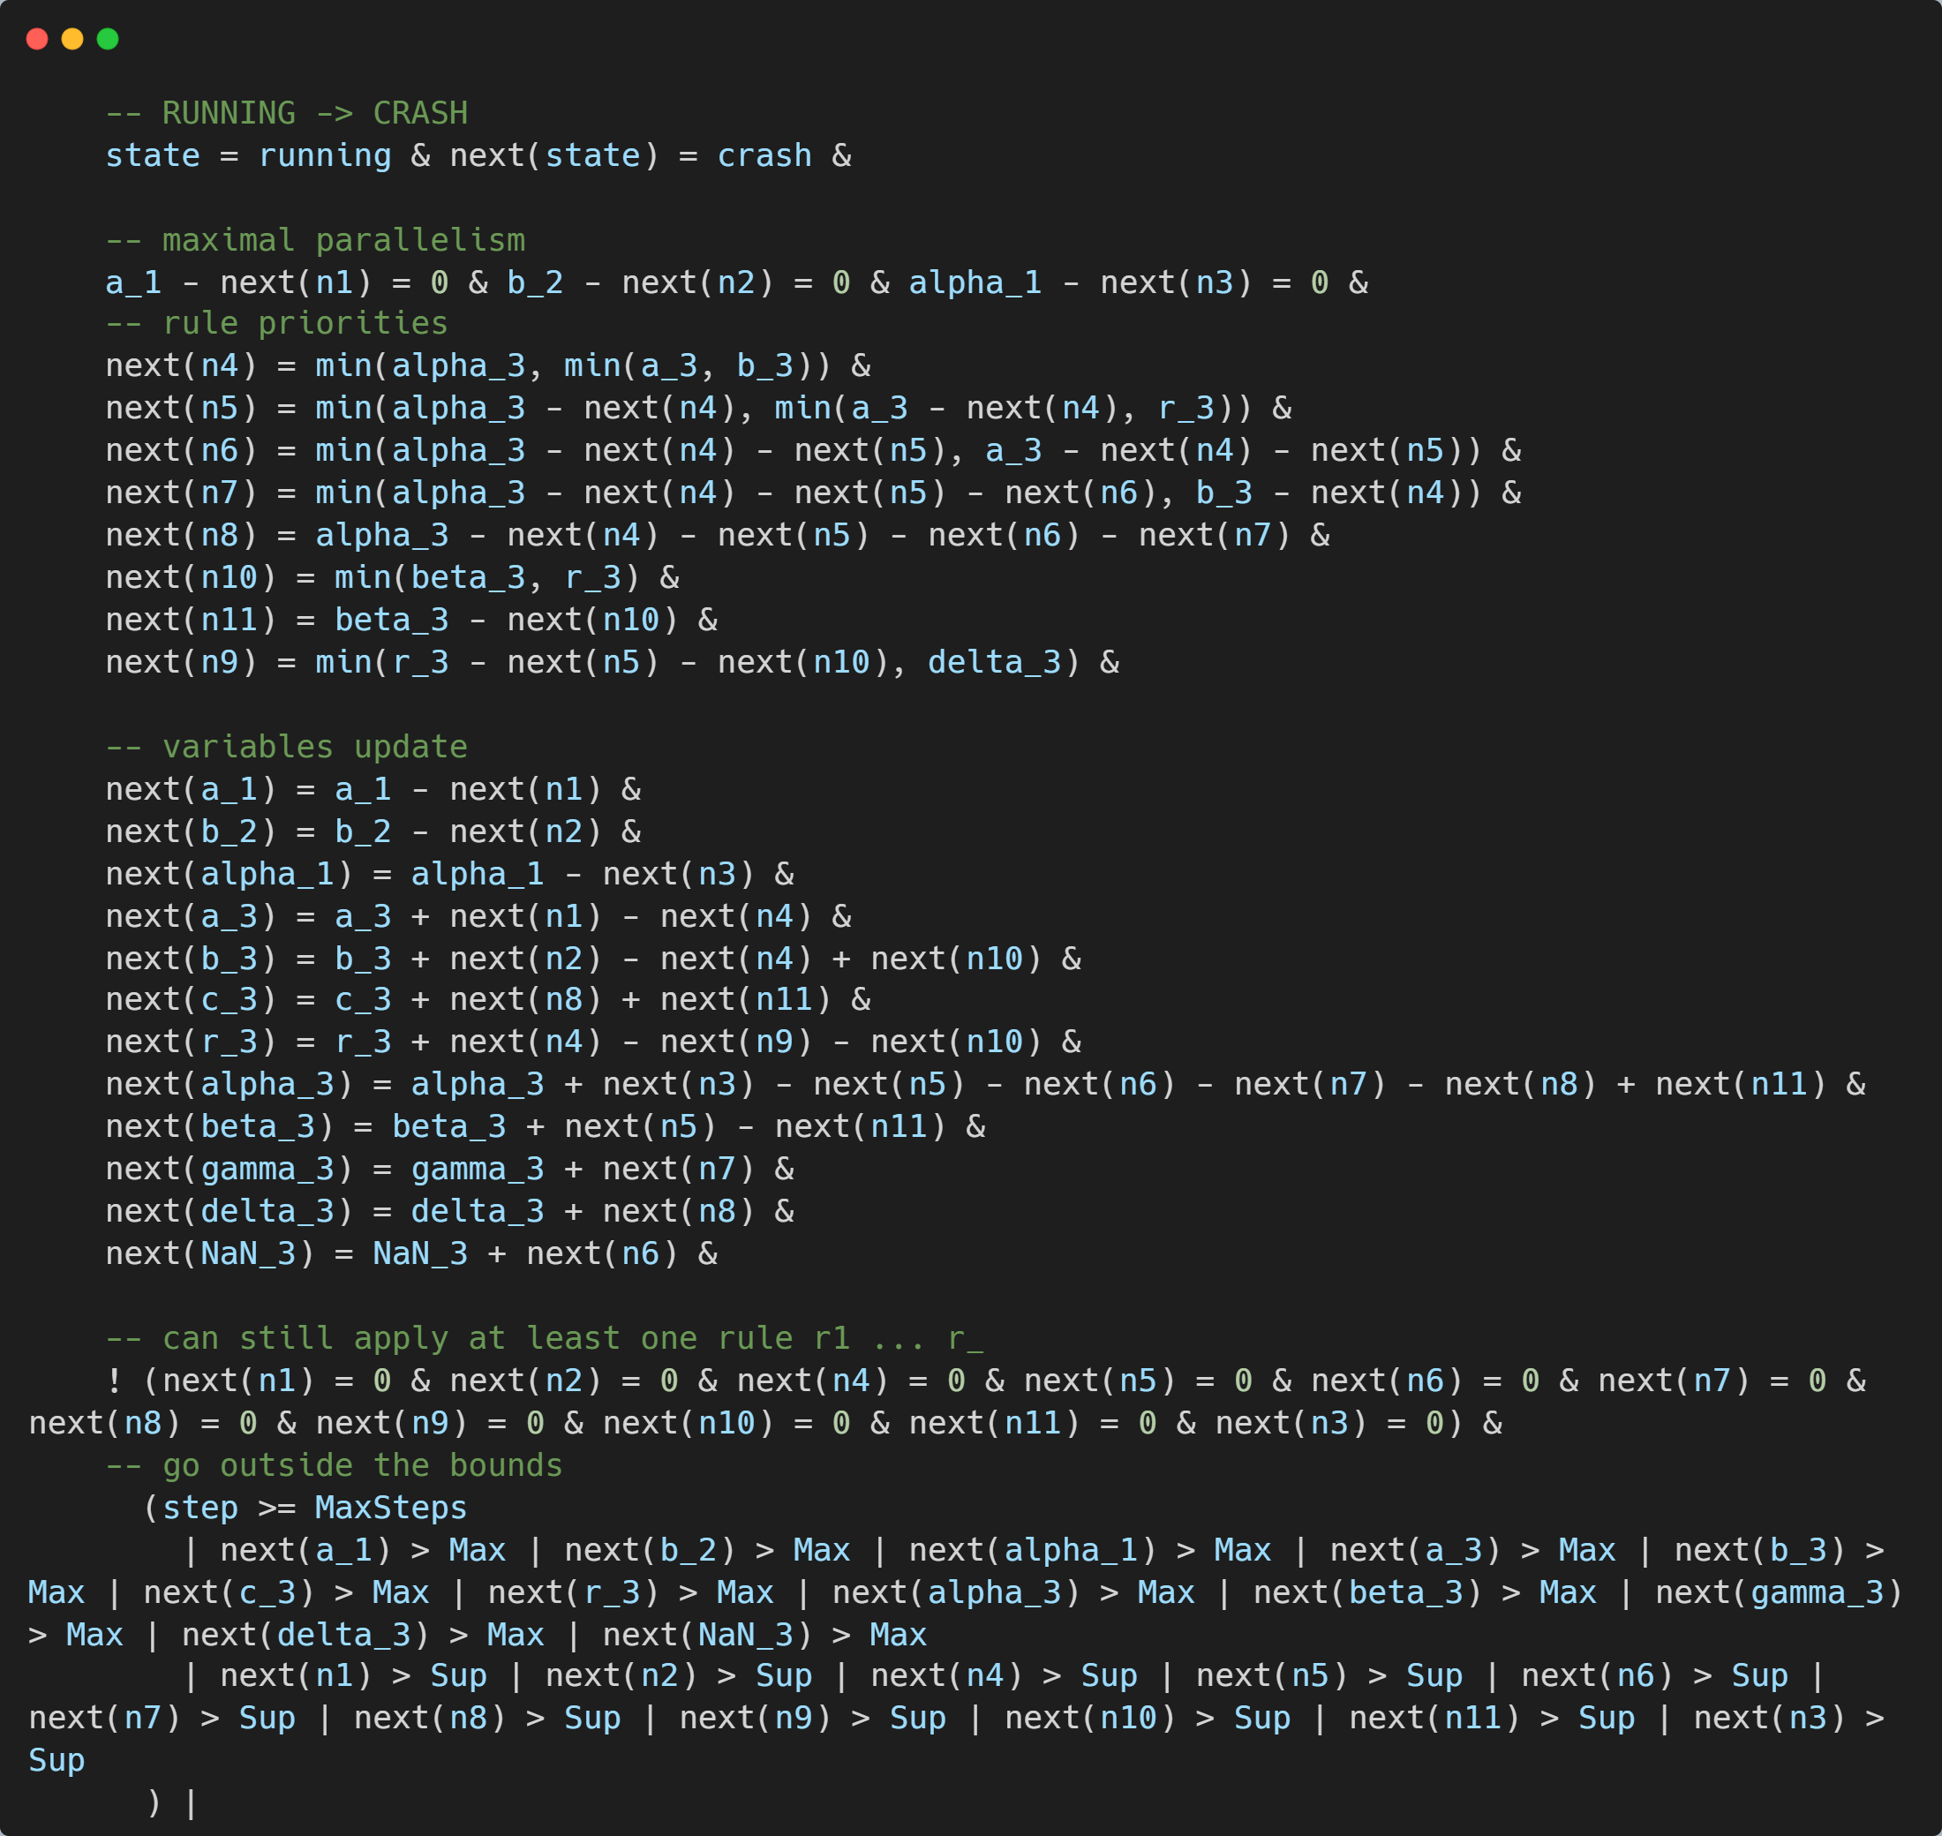

Slide 20
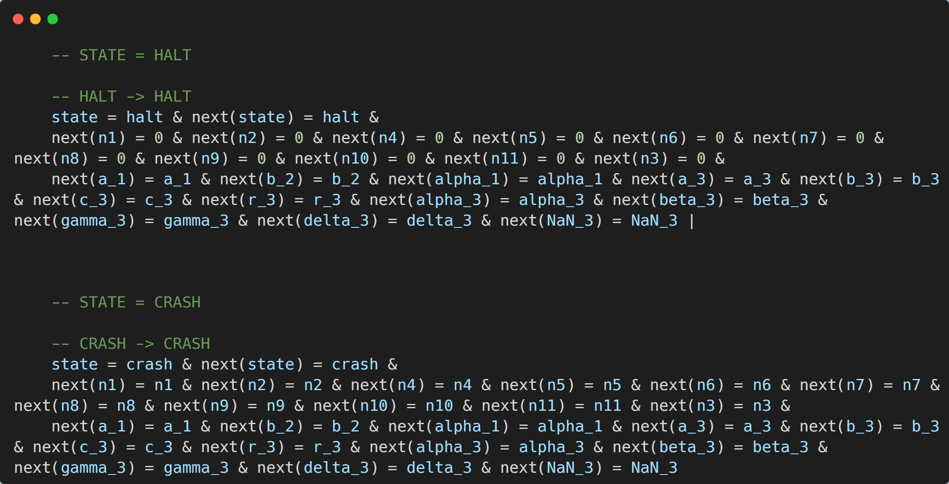

Slide 21
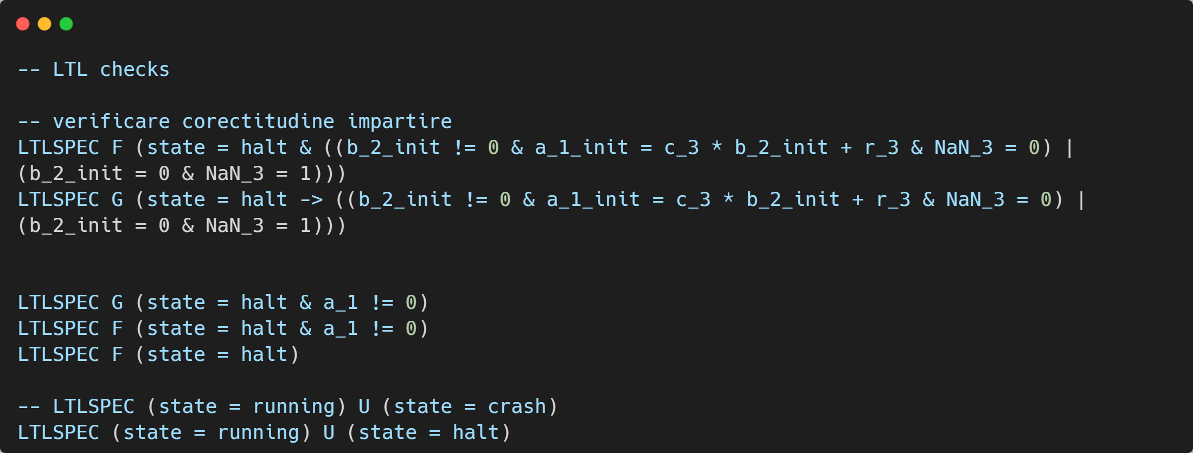

Slide 22
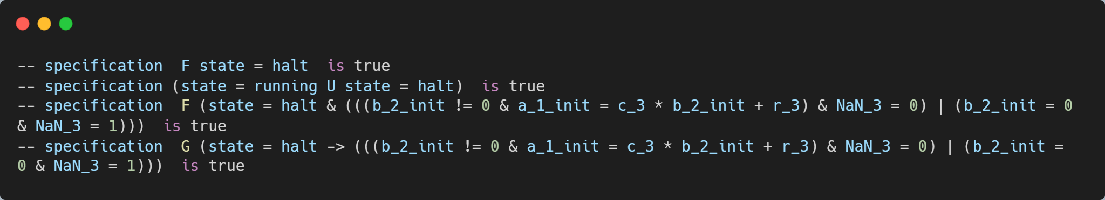
Rezultatul verificării sistemului

Slide 23
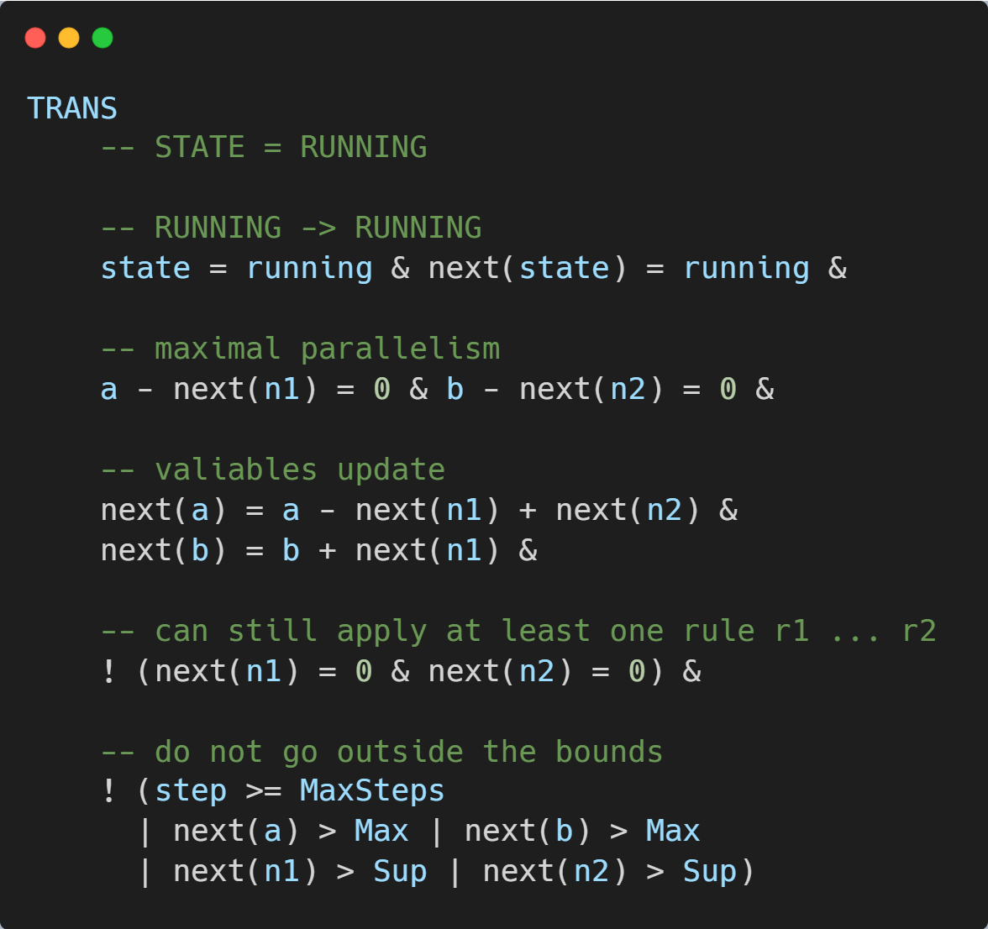
Codul NuSMV pentru numerele Fibonacci

Slide 24
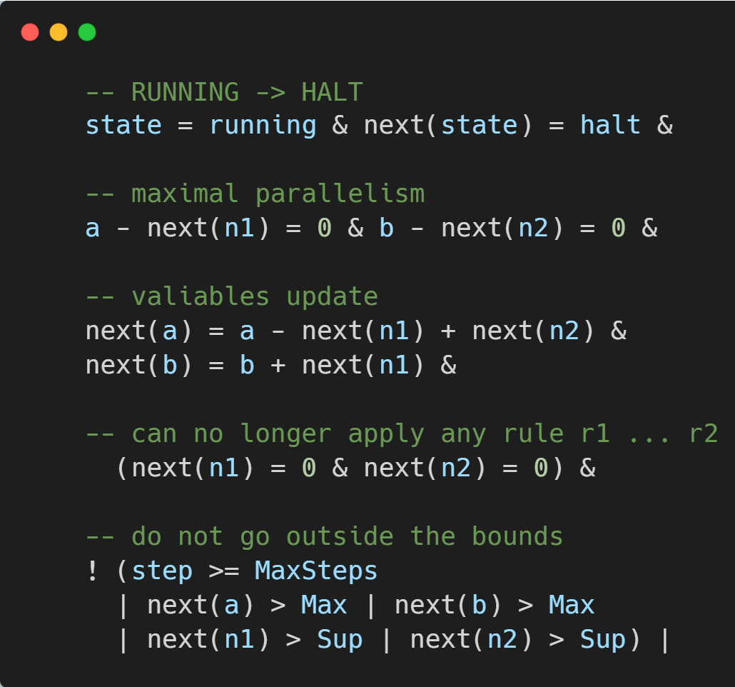
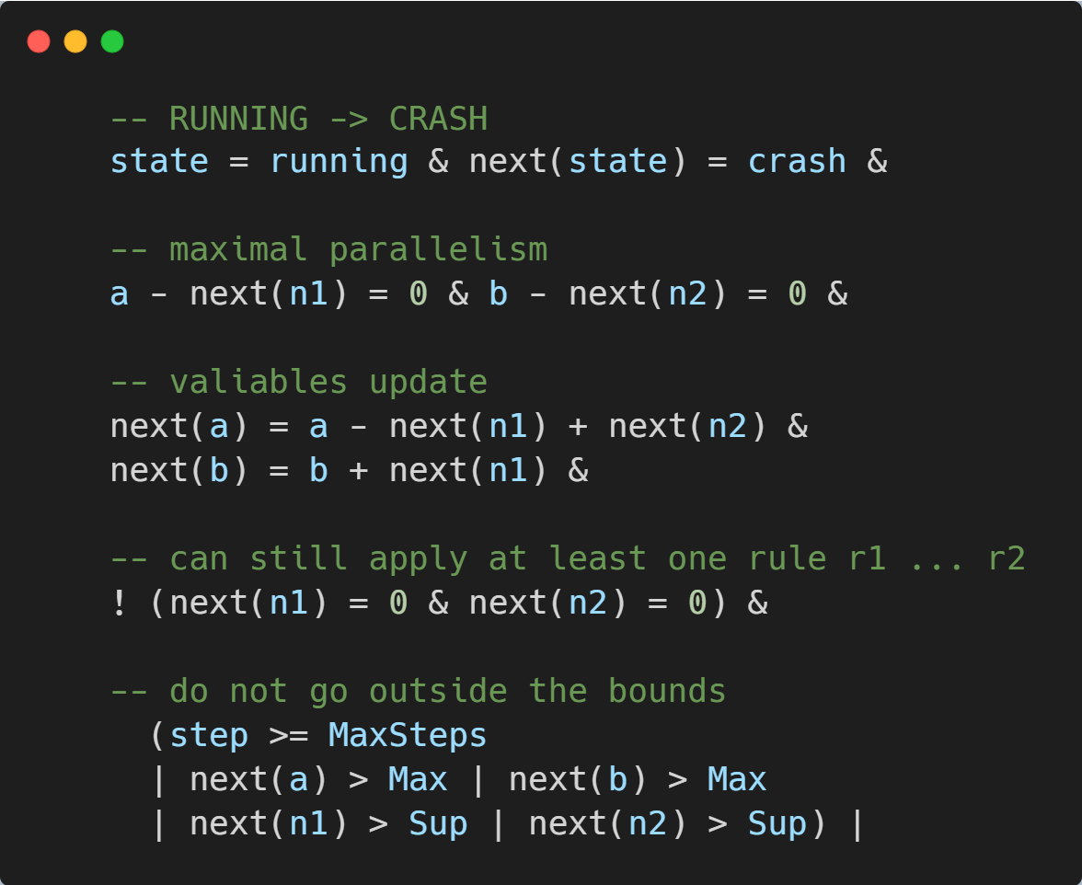

Slide 25
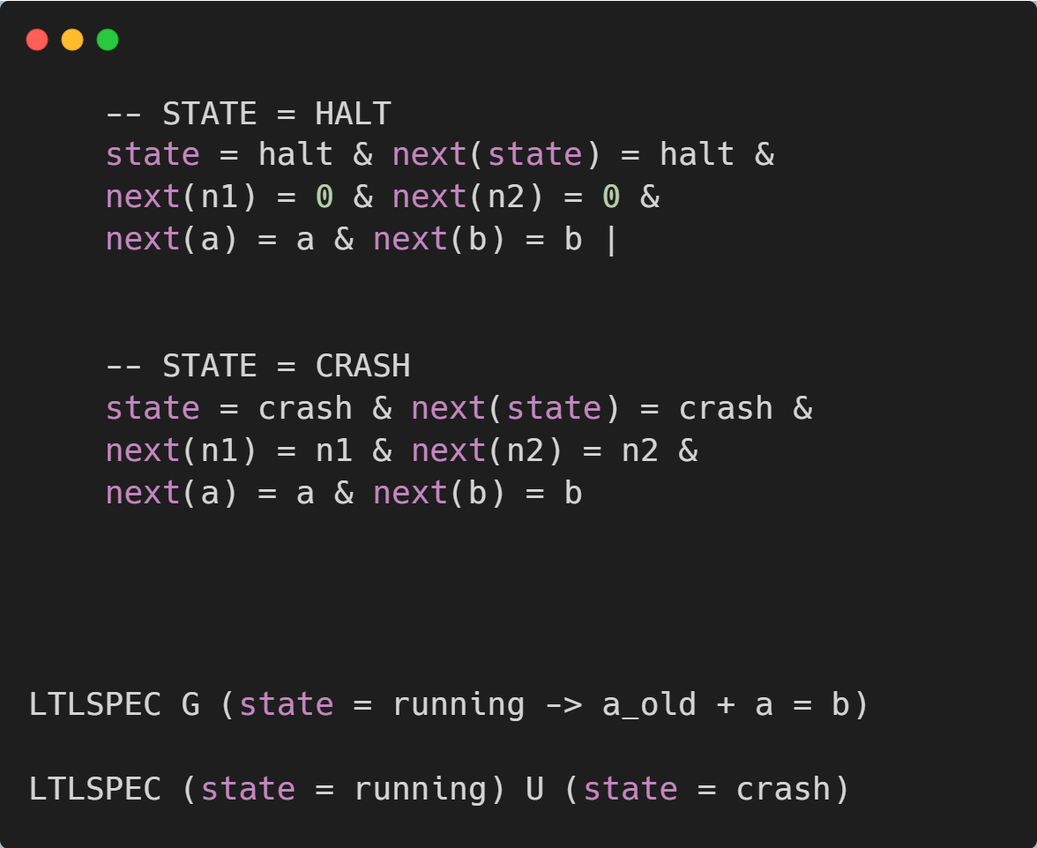

Slide 26
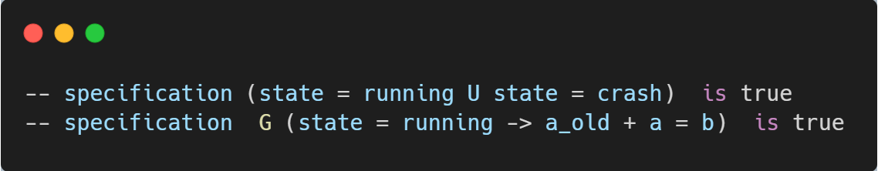
Rezultatul verificării sistemului

Slide 27
Bibliografie
An integrated approach to P systems formal verification
https://nusmv.fbk.eu/

